Slide 1


College of Business and Economics
Departement of Management
Chapter 1: The Nature of Entrepreneurship
Solomon Melese, PhD
Assistant Professor of Management

Slide 2
_{Chapter Learning Outcomes}
After completing this chapter, students should be able to:
▪Define the term entrepreneurship and entrepreneur
▪Identify types of entrepreneur
▪Recognize the role of entrepreneurship in the economy
▪Analyze the entrepreneurial competences
▪Understand creativity and innovation

Slide 3

1.1 Introduction
The word ‘entrepreneur’ is widely used, both in everyday conversation and as a technical term in management and economics.
Its origin from a French word, entreprender, where an entrepreneur was an individual commissioned to undertake a particular commercial project.
Several concepts are derived from the idea of entrepreneur: entrepreneurial, entrepreneurship, and entrepreneurial process.
Entrepreneurship: what the entrepreneur does.
Entrepreneurial: an adjective describing how the entrepreneur undertakes what he or she does.
The entrepreneurial process: he means through which new value is created as a result of the project: the entrepreneurial venture.

Slide 4

1.2 Historical Origin of Entrepreneurship
Ancient period :a person managing large commercial projects through the resources provided to him.
17th Century: a person who has signed a contractual agreement with the government to provide stipulated products or to perform service was considered as entrepreneur.
18th Century: the first theory of entrepreneur has been developed by Richard Cantillon.
He said that an entrepreneur is a risk taker.
Differentiation of the entrepreneurial role from capital providing role

Slide 5
Historical Origin of Entrepreneurship
late 19th and early 20th Century: an entrepreneur was viewed from economic perspectives. The entrepreneur organizes and operates an enterprise for personal gain.
In the middle of the 20th Century: the notion of an entrepreneur as an inventor as established.
Key Shift: From project management → Innovation application

Slide 6
1.3 Definitions of Entrepreneurship and Entrepreneur
1.Entrepreneurship is the process of identifying opportunities in the market place, arranging the resources required to pursue these opportunities and investing the resources to exploit the opportunities for long term gains. It involves creating incremental wealth by bringing together resources in new ways to start and operate an enterprise.
2.Entrepreneurship is the processes through which individuals become aware of business ownership then develop ideas for, and initiate a business.
3.Entrepreneurship can also be defined as the process of creating something different and better with value by devoting the necessary time and effort by assuming the accompanying financial, psychic and social risks and receiving the resulting monetary reward and personal satisfaction. In this case an individual should come up with something different and better in order to the named as entrepreneur.
4.Entrepreneurship is the art of identifying viable business opportunities and mobilizing resources to convert those opportunities into a successful enterprise through creativity, innovation, risk taking and progressive imagination

Slide 7
Core Elements of Entrepreneurship
Five Critical Elements
1. Ability to perceive opportunity
2. Ability to commercialize (innovation)
4. Ability to pursue systematically
3. Ability to pursue sustainably
5. Acceptance of risk or failure
Key Formula: Entrepreneurship = Creativity + Innovation

Slide 8
An entrepreneur can be defined as follows:
1)An entrepreneur is any person who creates and develops a business idea and takes the risk of setting up an enterprise to produce a product or service which satisfies customer needs.
2)An entrepreneur can also be defined as a professional who discovers a business opportunity to produce improved or new goods and services and identifies a way in which resources required can be mobilized.
3)An entrepreneur is an individual who: has the ability to identify and pursue a business opportunity; undertakes a business venture; raises the capital to finance it; gathers the necessary physical, financial and human resources needed to operate the business venture; sets goals for him/herself and others; initiates appropriate action to ensure success; and assumes all or a major portion of the risk!
4)An entrepreneur is a person who: create the job not a job-seeker; has a dream, has a vision; willing to take the risk and makes something out of nothing

Slide 9
Who is an Entrepreneur?
5)Other definition, views the term entrepreneur from three perspectives; i.e. from the economist, psychologist and capitalist philosopher’s point of view.
Economist's View
Brings resources together, introduces innovations, and creates economic value through combining factors of production
Psychologist's View
Driven by achievement motivation, experimentation needs, and desire to create something meaningful
Capitalist's View
Creates wealth for self and others, generates employment, and contributes to economic development
In general, entrepreneur refers to the person and entrepreneurship defines the process. Both men and women can be successful entrepreneurs; it has nothing to do with gender. All entrepreneurs are business persons, but not all business persons are entrepreneurs.

Slide 10



1.4 Types of Entrepreneurs
Intrapreneur
Entrepreneurial Organization
Individual Entrepreneur
someone who started; acquired or franchised his/her own independent organization. The major portion of this module is also devoted to describe the basic features and activities of the individual entrepreneur.
a person who does entrepreneurial work within large organization. The process by which an intrapreneur affects change is called Intrapreneurship.
The entrepreneurial function need not be embodied in a physical person. Every social environment has its own way of filling the entrepreneurial function.

Slide 11
1.5 Role of Entrepreneurs in Economic Development
Entrepreneurial development is a key input in economic development.
Helps achieve:
Industrial development
Balanced regional growth
Employment generation
Leads to:
Higher per capita income
Improved standard of living
Increased government revenue

Slide 12
Role of Entrepreneurs in Economic Development
Improvement in per capita Income/Wealth Generation
Generation of Employment Opportunities
Inspire others Towards Entrepreneurship
Balanced Regional Development
Enhance the Number of Enterprise
Provide Diversity in Firms
Economic Independence
Combine Economic factors
Provide Market efficiency
Accepting Risk
Maximize Investor’s Return

Slide 13
1.6 Entrepreneurial Mindset
Entrepreneurial mindset refers to the thinking pattern that drives individuals to identify and pursue opportunities.
Who Becomes an Entrepreneur?
Anyone with the following characteristics can become an entrepreneur:
The Young Professional
The Inventor
The Excluded

Slide 14

Qualities of an Entrepreneur
1)Opportunity-seeking: An opportunity is a favorable set of circumstances that creates a need for a new product, service or business. It includes access to credit, working premises, education, trainings etc. An entrepreneur always seeks out and identifies opportunities. He/she seizes an opportunity and converts it into a realistic and achievable goal or plan.
2)Persevering: An entrepreneur always makes concerted efforts towards the successful completion of a goal. An entrepreneur perseveres and is undeterred by uncertainties, risks, obstacles, or difficulties which could challenge the achievement of the ultimate goal.
3)Risk Taking: The best entrepreneurs tend to:-
Set their own objectives where there is moderate risk of failure and take calculated risks
Gain satisfaction from completing a job well
Not be afraid of public opinion, skepticism
Take responsibility for their own actions
Importance of Risk-taking: Build self confidence, Create a feeling of leadership, Create strong motivation to complete a job well

Slide 15
Qualities of an Entrepreneur
4)Demanding for Efficiency and Quality
Efficiency: Being efficient means producing results with little wasted effort.
5) Information-seeking: Successful entrepreneurs do not rely on guesswork and do not rely on others for information. Instead, they spend time collecting information about their customers, competitors, suppliers, relevant technology and markets.
6)Goal Setting
A Goal - is a general direction, or long-term aim that you want to accomplish. It is not specific enough to be measured. It is large in scope, not necessarily time-bound, and is something that people strive for by meeting certain objectives which will hopefully add up to eventually achieving the goal.
Objectives - are specific and measurable. They are concise and specific. Think of the word “object.” You can touch it, it’s there, it’s actual, and it’s finite.
An entrepreneur must have a goal and an objective which is specific, measurable, attainable relevant, and time bound (SMART).

Slide 16

SMART Objectives
Specific: Great goals are well-defined and focused.
Measurable: A goal without a measurable outcome is like a sports competition without a scoreboard or scorekeeper.
Attainable: Far too often, entrepreneurs can set goals which are beyond their reach. Dream big and aim for the stars but keep one foot firmly based in reality.
Relevant: Achievable business goals are based on the current conditions and realities of the business climate.
Time-Based: Business goals and objectives just don’t get done when there’s no time frame tied to the goal-setting process.

Slide 17
Qualities of an Entrepreneur
7)Planning: Planning is making a decision about the future in terms of what to do, when to do, where to do, how to do, by whom to do and using what resources. An effective entrepreneur therefore usually plans his/her activities and accounts as best as they can for unexpected eventualities.
8)Persuasion and Networking
Persuasion is a way of convincing someone to get something or make a decision in your favor.
Networking is an extended group of people with similar interests or concerns who interact and remain in informal contact for mutual assistance or support.
9) Building Self-confidence: Self-confidence is the state of being certain that a chosen course of action is the best or most effective given the circumstances. Confidence can be described as a subjective, emotional state of mind, but is also represented statistically as a confidence level within which one may be certain that a hypothesis will either be rejected or deemed plausible.

Slide 18
Qualities of an Entrepreneur
10)Listening to Others: An entrepreneur does not simply impose his/her idea on others. Rather, he/she listens to other people in their sphere of influence, analyses their input in line with his/her own thinking and makes an informed decision.
11)Demonstrating Leadership: An entrepreneur does not only do things by him/herself, but also gets things done through others. Entrepreneurs inspire, encourage and lead others to undertake the given duties in time.

Slide 19
Entrepreneurial Skills
A skill is knowledge demonstrated through action.
It is the ability to perform in a certain way.
An entrepreneur has a good business idea and turns it into reality.
Turning an idea into reality calls upon two sorts of skills, these are:
General management skills and
People management skills

Slide 20
General Management Skills:
Strategy Skills
Planning Skills
Marketing Skills
Financial Skills
Project Management Skills
Time Management Skills

Slide 21
People Management Skills:
Communication Skills
Leadership Skills
Motivation Skills
Delegation Skills
Negotiation Skills

Slide 22
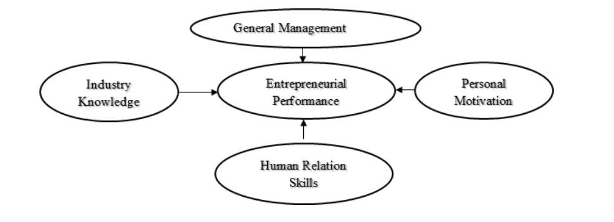
Fig1.1: entrepreneurial skills

Slide 23
The Entrepreneurial Tasks
Owning Organizations:
Founding New Organizations:
Bringing Innovations to Market
Identification of Market Opportunity
Application of Expertise
Provision of leadership
The entrepreneur as manager

Slide 24

Wealth of the Entrepreneur
Wealth is money and anything that money can buy. It includes money, knowledge and assets of the entrepreneur.
Who Benefits from the entrepreneur’s Wealth?
Employees:
Investors:
Supplier
Customers
The local community
Government

Slide 25
Entrepreneurship and Environment
Business environment refers to external factors influencing a business's operations and effectiveness.
Can be healthy (favorable for growth) or unhealthy (hostile or unfavorable).
Businesses and their environment interact continuously.

Slide 26
Interaction with Environment
Economic systems and environmental conditions affect business success.
Firms must adjust to prevailing conditions.
Businesses can also influence and shape their environment.
Successful enterprises improve economic and social conditions.

Slide 27
Benefits of Studying Business Environment
Provides essential information for successful operations.
Opens avenues for new ventures and innovative ideas.
Enables adoption of a dynamic approach with changing conditions.
Helps entrepreneurs make the environment hospitable to business growth.

Slide 28
Phases of Business Environment
Business environment can be classified into:
External Environment – factors outside the business, hard to control.
Internal Environment – factors within the business, under management control.
Objective: Gather information from multiple sources to improve business success.

Slide 29
External Environment
Economic: Structure of economy, policies, trade, growth, national income.
Legal: Knowledge of business laws; consult agencies, books, and legal experts.
Political: Understand political systems; consider public opinion in decisions.
Socio-Cultural: Values, norms, beliefs, traditions, and societal openness to innovation.
Demographic: Population size, age, sex, education, income distribution.

Slide 30
Internal Environment
Raw Material: Availability now and in future; critical for uninterrupted operations.
Production/Operations: Machinery, tools, and techniques for production.
Finance: Start-up, fixed, and running expenses; sources of funding.
Human Resource: Skills needed, availability, cost, and retention challenges.

Slide 31
Environmental Factors Affecting Entrepreneurship
Entrepreneurial activity is shaped by a combination of financial, institutional, cultural, and personality factors.
Personal backgrounds of entrepreneurs are influenced by the environment of upbringing and work.
Interaction between entrepreneurs and environment is ongoing.
Entrepreneurs adapt to and/or modify the environment to meet business needs.

Slide 32
Environmental Factors Hindering Entrepreneurship
🖙 Sudden changes in Government policy.
🖙 Sudden political upsurge.
🖙 Outbreak of war or regional conflicts.
🖙 Political instability or hostile Government attitude towards industry.
🖙 Excessive red-tapism and corruption among Government agencies.
🖙 Ideological and social conflicts.
🖙 Unreliable supply of power, materials, finance, labor and other inputs.
🖙 Rise in the cost of inputs.
🖙 Unfavorable market fluctuations.
🖙 Non-cooperative attitude of banks and financial institutions.

Slide 33

1.7 Creativity, Innovation and Entrepreneurship
"The tendency to generate or recognise ideas, alternatives, or possibilities useful in solving problems, communicating, and entertaining"
Process
Can be learned and improved with practice and dedication
Ideas
Results have potential value and practical application
Recombining
Unexpected combinations of elements create breakthroughs
Requirements for Creativity
View things in new ways
Generate new possibilities
Create unique alternatives
Flexibility in thinking
Tolerance of ambiguity

Slide 34





Steps in the Creative Process
1. Opportunity/Problem Recognition
Discover new opportunity exists or identify problem needing resolution
2. Immersion
Concentrate on problem, collect relevant information, dream up alternatives without
evaluation
3. Incubation
Keep information in mind, subconscious arrangement, pattern formation
4. Insight
Solution flashes unexpectedly, often during unrelated activities
5. Verification & Application
Prove solution merit, gather evidence, persuade, experiment

Slide 35
Barriers to Creativity
1.searching for the one ‘right’ answer
2.focusing on being logical
3.blindly following the rules
4.constantly being practical
5.viewing play as frivolous
6.becoming overly specialized
7.avoiding ambiguity
8.fearing looking foolish
9.fearing mistakes and failure
10.believing that ‘I’m not creative

Slide 36

Innovation
It is the implementation of new idea at the individual, group or organizational level.
Innovation is a process of intentional change made to rate value by meeting opportunity and seeking advantage.
There are four distinct types of innovation, these are as follows:
Invention - described as the creation of a new product, service or process
Extension - the expansion of a product, service or process
Duplication - defined as replication of an already existing product, service or process
Synthesis - the combination of existing concepts and factors into a new formulation

Slide 37
The Innovation Process
Analytical planning: carefully identifying the product or service features, design as well as the resources that will be needed.
Resources organization: obtaining the required resources, materials, technology, human or capital resources
Implementation: applying the resources in order to accomplish the plans
Commercial application: the provision of values to customers, reward employees and satisfy the stakeholders.

Slide 38
Areas of Innovation
New product:
New Services:
New Production Techniques:
New Way of Delivering the Product or Service to the Customer:
New Operating Practices
New Means of Informing the Customer about the Product
New Means of Managing Relationship within the Organization
New Ways of Managing Relationships between Organizations

Slide 39
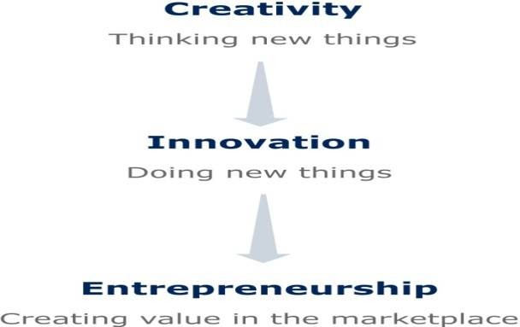
From Creativity to Entrepreneurship
Creativity is the ability to develop new ideas and to discover new ways of looking at problems and opportunities.
Innovation is the ability to apply creative solution to those problems and opportunities in order to enhance people’s lives or to enrich society.
Fig 1.2: Flow of Creativity, Innovation and Entrepreneurship

Slide 40


